Slide 1
SHERLOCK HOLMES
The Machine Investigator

Slide 2
Introduction
Artificial Intelligence research includes problem solving as one of the major fields which intelligent tasks are automated and interpreted as a series of problems needs to be solved. Crime Investigation process suffers from various problems. One of the biggest problems is finding crime offense and suspect.
Imagine a crime case with many suspects involved where each of the suspects has various motives for the murder which makes the case complicated and the amount of information would be large for a detective to process. Taking into consideration that the knowledge about crime event may not only enough for investigator to deduce the crimes, he may check on the crime cases solved previously that have similar ground than that of current one, finding the generalized information to solve the current case problem. Using this new information would leads to many deductions including the crime offense and even the murderer.
The project, Sherlock Homes: the Machine Investigator aims at deploying a machine learning algorithm which would help in investigating crime scenes. The algorithm would take case evidences, witnesses and forensic reports as inputs, draws some of the inferences on crime offense and give output. The algorithm also provides Bayesian network for more clear understanding of the findings.

Slide 3
Objective and Scope
The main objective is to develop a machine learning algorithm which would help in investigating crime scenes. The algorithm is used in such a way that investigator can use any piece of information gathered from crime scene to predict the crime offense.
Some of the specific objectives are observed as below:
This could possibly make the work of the investigator much easier and more efficient in solving the crime case.
The traditional approach of crime investigation is usually time-consuming, resulting in a lot of delay and often generally inefficient leading to high cost.
The system would not require to be developed manually as it could self-develop.
This makes possible for investigator to go beyond the human level thinking as the machine would start to learn the work itself with effect of time and increase in data.

Slide 4
Crime Investigation
A normative definition views crime as deviant behavior that violates prevailing norms – cultural standards prescribing how humans ought to behave normally.
A crime scene is any physical scene, anywhere that may provide potential evidence to an investigator. It may include a person’s body, any type of building, vehicles, and places in the open air or objects found at those locations. “Crime scene examination” therefore refers to an examination where forensic or scientific techniques are used to preserve and gather physical evidence of a crime.
To answer all the questions as to determine how, when, where, how and why the crime has been committed is included in the process of crime investigation

Slide 5
Bayes’ Theorem
Let’s consider that event B has occurred, the interested domain would be narrowed down to consider only those things which are inside the circle of B. Now let’s consider that A occurs. We will now consider only that part in A which are related to B, which is given by B∩A. In such situation, conditional probability is given as the joint probability of events B and A as both events have occurred simultaneously.
The Bayes’ Theorem is one of the best algorithms using conditional probability approach based on random variables.
If the value of A is known but the value of B is unknown. The value of B is dependable on the value of A. The probability of A would be given by P(A), which is called as prior. Once this value is known then value of B can be calculated as P(B|A). This is known as posterior probability. Then Bayes’ Theorem can be given as:
posterior=prior x likelihood/normalizer
Here, likelihood is the conditional probability of P(A|B), normalizer is the value of P(A). The equation can be rewritten as:
P(B|A)=P(A)P(A|B)/P(B)

Slide 6
Methodology
Finding information about the current system
Choosing algorithm to be used
Workbench Selection
Feasibility Study
Implementing algorithm on both workbenches
Comparing the result
Documentation

Slide 7
Proposed Technology
R
R is a language and environment for statistical computing and graphics. R provides a wide variety of statistical and graphical techniques.
One of R’s strengths is the ease with which well-designed publication-quality plots can be produced, including mathematical symbols and formulae where needed. Great care has been taken over the defaults for the minor design choices in graphics, but the user retains full control.
MATLAB
MATLAB (MATrix LABoratory) is a multi-paradigm numerical computing environment and fourth-generation programming language. A proprietary programming language developed by MathWorks, MATLAB allows matrix manipulations, plotting of functions and data, implementation of algorithms, creation of user interfaces, and interfacing with programs written in other languages, including C, C++, C#, Java, Fortran and Python.

Slide 8
Feasibility Study
Economical Feasibility
The project includes the use of open source software such as R and MATLAB (trial version). The project can be run on all version of Windows OS with R and MATLAB pre-installed. Therefore, this project is economically feasible.
Technical Feasibility
Every component of project uses open source software such as R and MATLAB(trial version) for implementing algorithm and Microsoft Word for documentation. These software are e easy to use. Therefore, this project is technically feasible.
Legal Feasibility
The project is legally feasible. It uses only the open source or trial version of software and easily available hardware such as Windows Operating System.

Slide 9
The Mystery of Murder
The detective appointed for the case.
Vague idea--murder or suicide.
The body found –Male (Post mortem report) -- stabbed in the stomach.
The body -- name – Mr. Mahesh.
Weapon found – Paper Cutter (in right hand)
The challenge -- dealing with the uncertain values.
Detective starts with an uncertainty of murder.
Therefore,
Probability of murder =0.50 (50%)

Slide 10
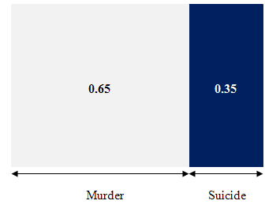
Taking random variable – Offense
Hence,
P(offense=murder)=0.5
P(offense=suicide)=0.5
Mahesh was left handed (Family Members Confirmed)
P(offense=murder)=0.65
P(offense=suicide)=0.35

Slide 11
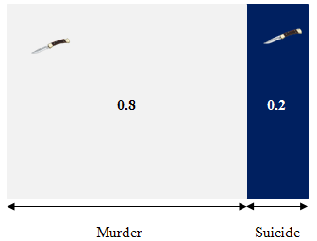
Considering Evidence
New Weapon is found – Knife
Random Variable introduced – Weapon
If weapon is knife:
P(weapon=knife | offense=murder)=0.8
P(weapon=knife | offense=suicide)=0.2

Slide 12
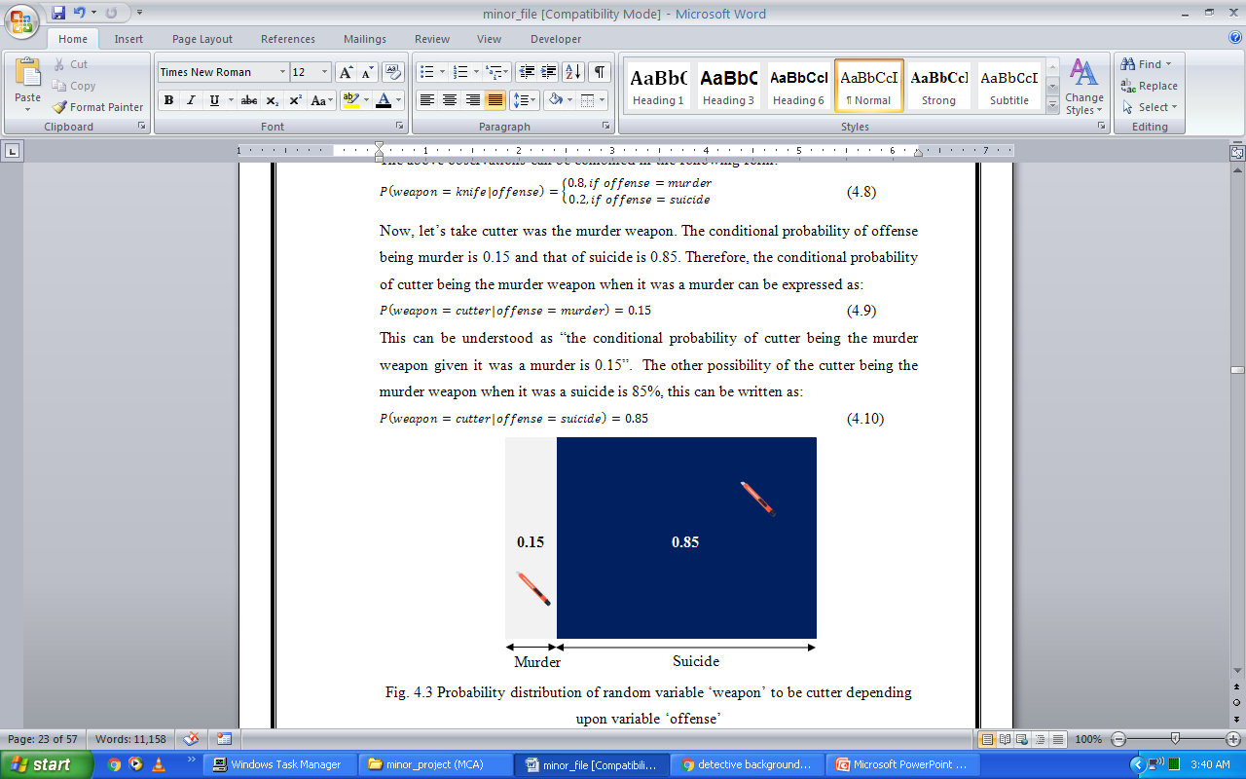
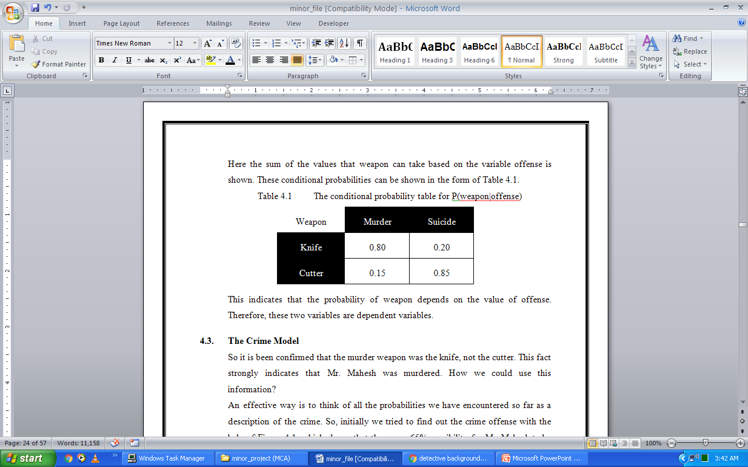
If weapon is cutter:
P(weapon=cutter | offense=murder)=0.15
P(weapon=cutter | offense=suicide)=0.85
Conditional Probability
P(weapon | offense)

Slide 13
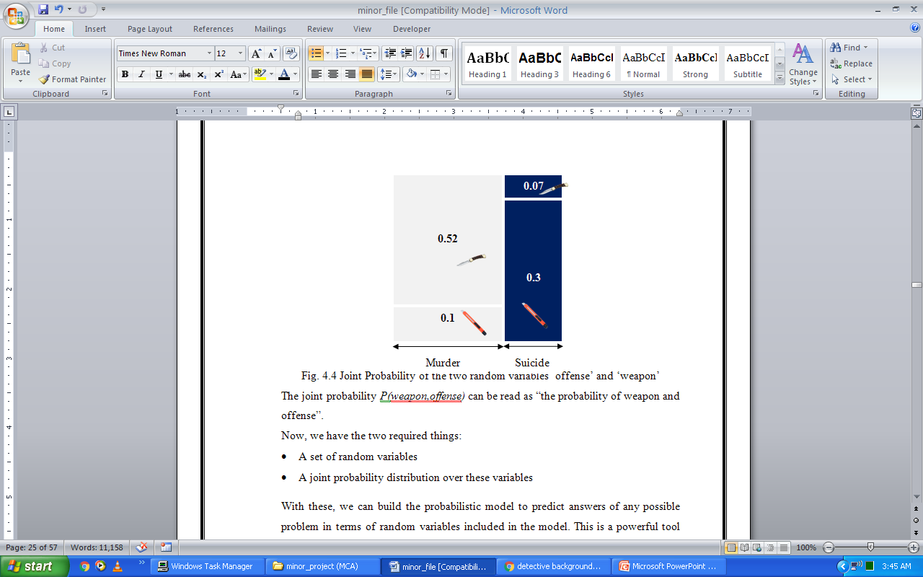
The Crime Model
Joint Probability
P(weapon,offense)=P(offense) P(weapon|offense)

Slide 14
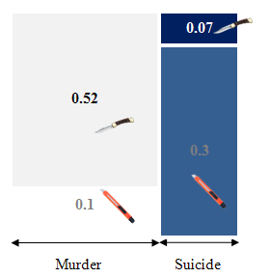
Weapon = Knife

Slide 15
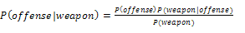
P(offense=murder | weapon=knife)
=0.52/(0.52+0.07)
=0.88 (approx.)
P(offense=suicide | weapon=knife)
=0.07/(0.52+0.07)
=0.12 (approx.)

Slide 16
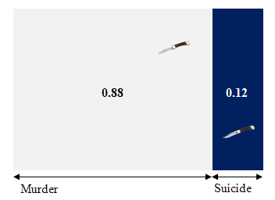
This is a murder

Slide 17
Data Collection
The dataset available in this paper has been collected from the Sony TV’s Crime Patrol Series. This dataset contains twelve types of tables that can be joined together to form a collective dataset.

Slide 18
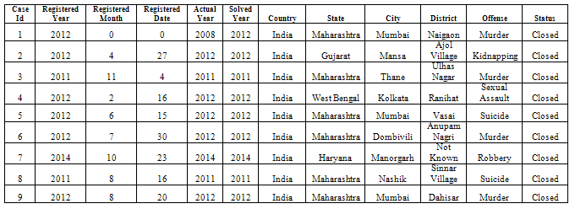
Case Files

Slide 19
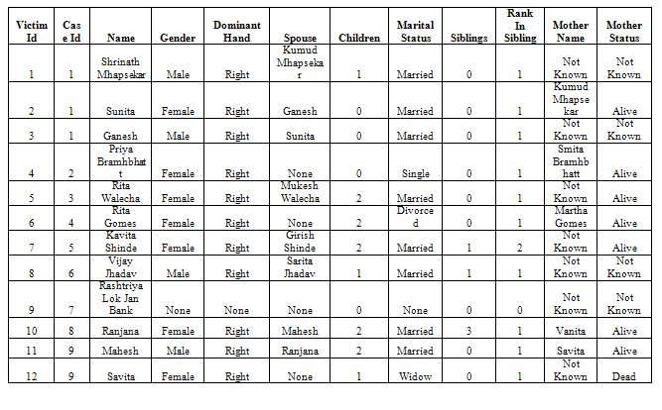
Victim Files

Slide 20
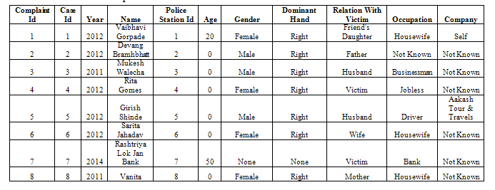
Complaint Files

Slide 21
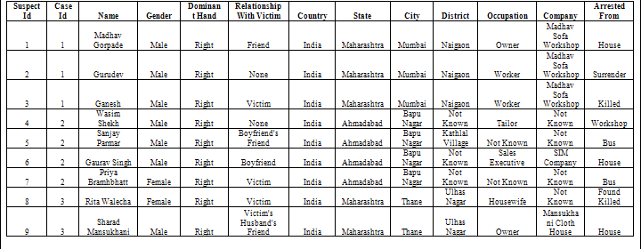
Suspect Files

Slide 22
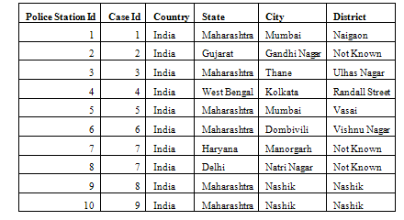
Police Station Files

Slide 23
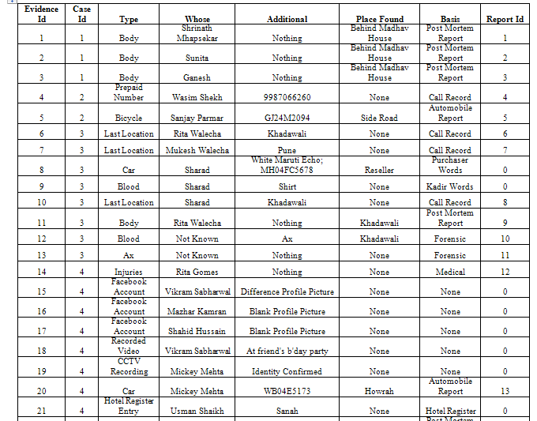
Evidence Files

Slide 24
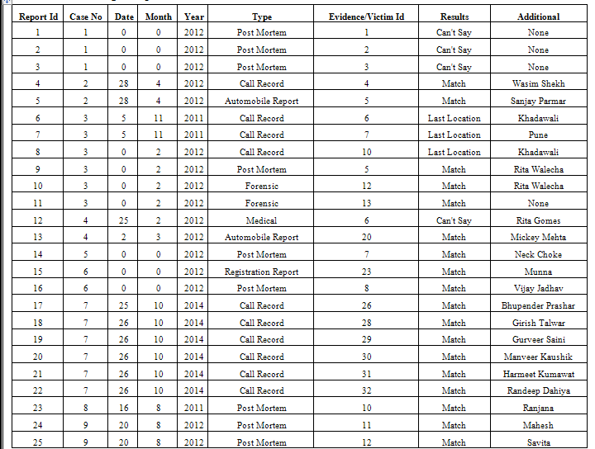
Report Files

Slide 25
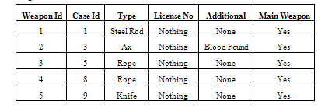
Weapon Files

Slide 26
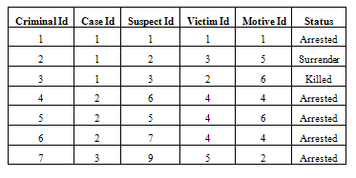
Criminal Files

Slide 27
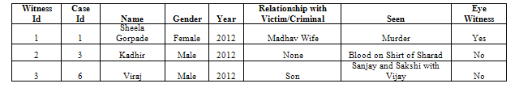
Witness Files

Slide 28
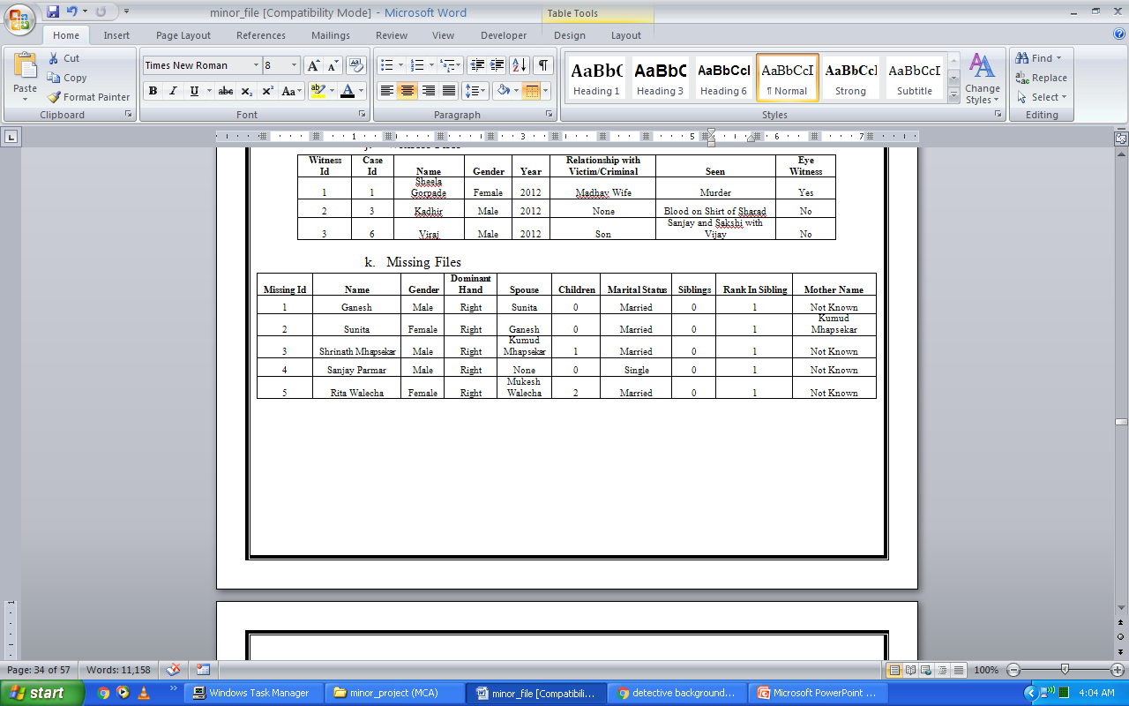
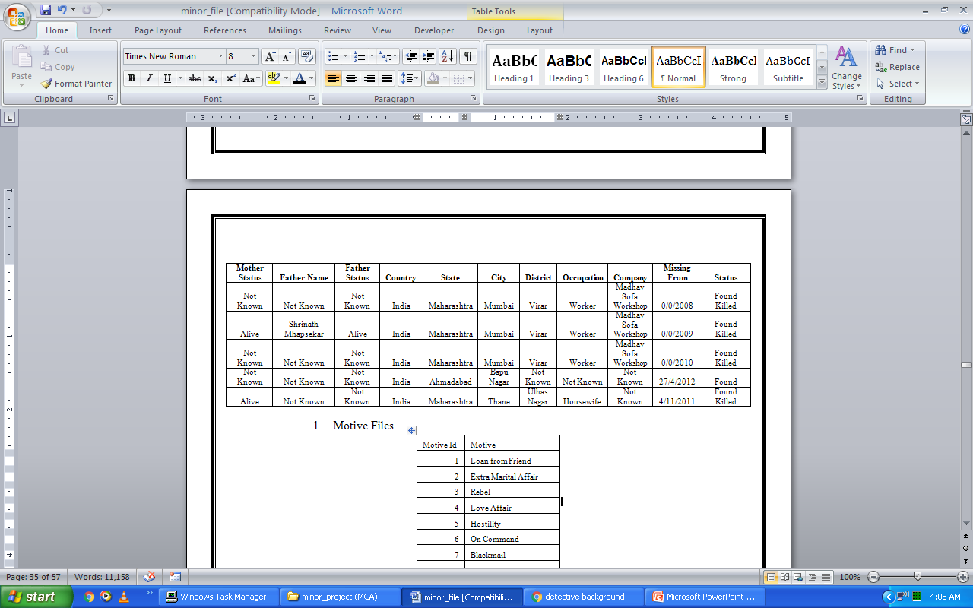
Missing Files

Slide 29
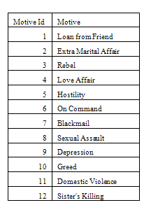
Motive Files

Slide 30
Data Preprocessing
To impose the final algorithm on the dataset, it is necessary to preprocess the data to make it in the standard and normalize form. In both, the data is firstly preprocessed and then Bayes theorem is applied in both workbenches. The accuracy and performance is calculated and compared.
Data preprocessing is often neglected but it is a very vital part for normalizing any kind of data. Data Preprocessing consists of data cleaning, data integrity, data transformation and data reduction. Data cleaning refers to the elimination of noisy incomplete and inconsistent data from the given dataset. This includes missing value treatment, data smoothening, etc. Data integrity refers to combining the data from different sources. Data transformation consists of transforming or converting the data into appropriate form. Data reduction means reducing the volume of data in a way that it would not affect the data integrity.

Slide 31
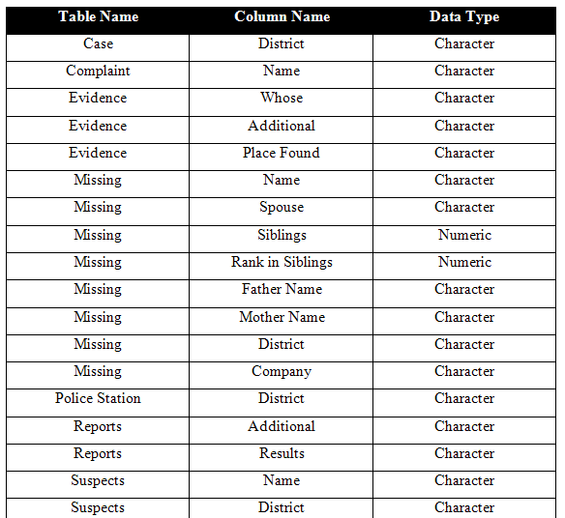

Slide 32
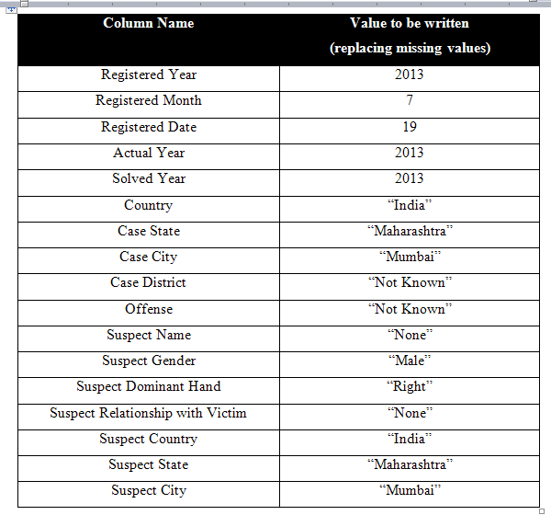

Slide 33
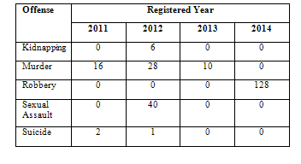
Relationship of Variables
In order to apply Bayes’ Theorem on this data, we need to find the relationship between the different attributes of the given data set. For this, we need to find the number of observation for every kind of offense.

Slide 34
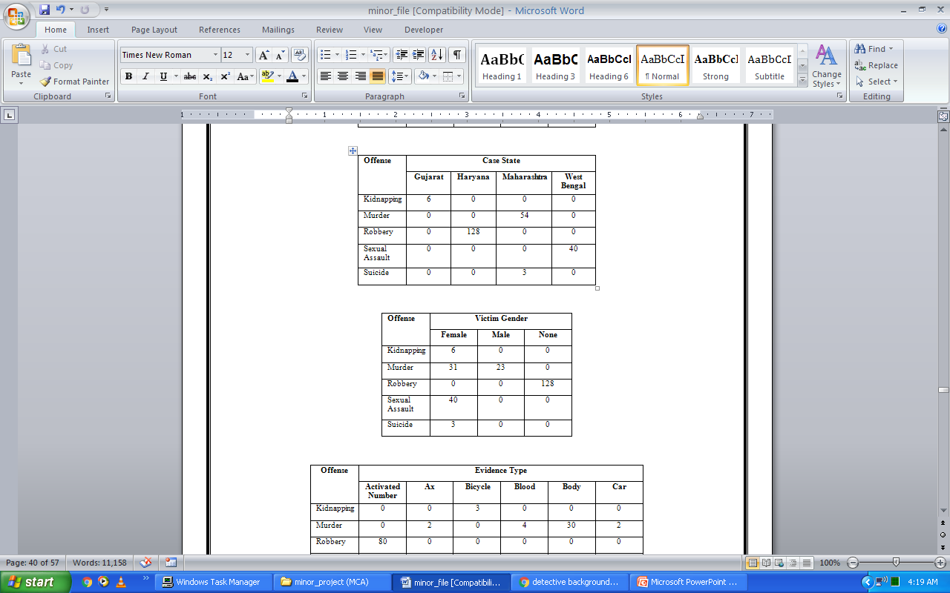
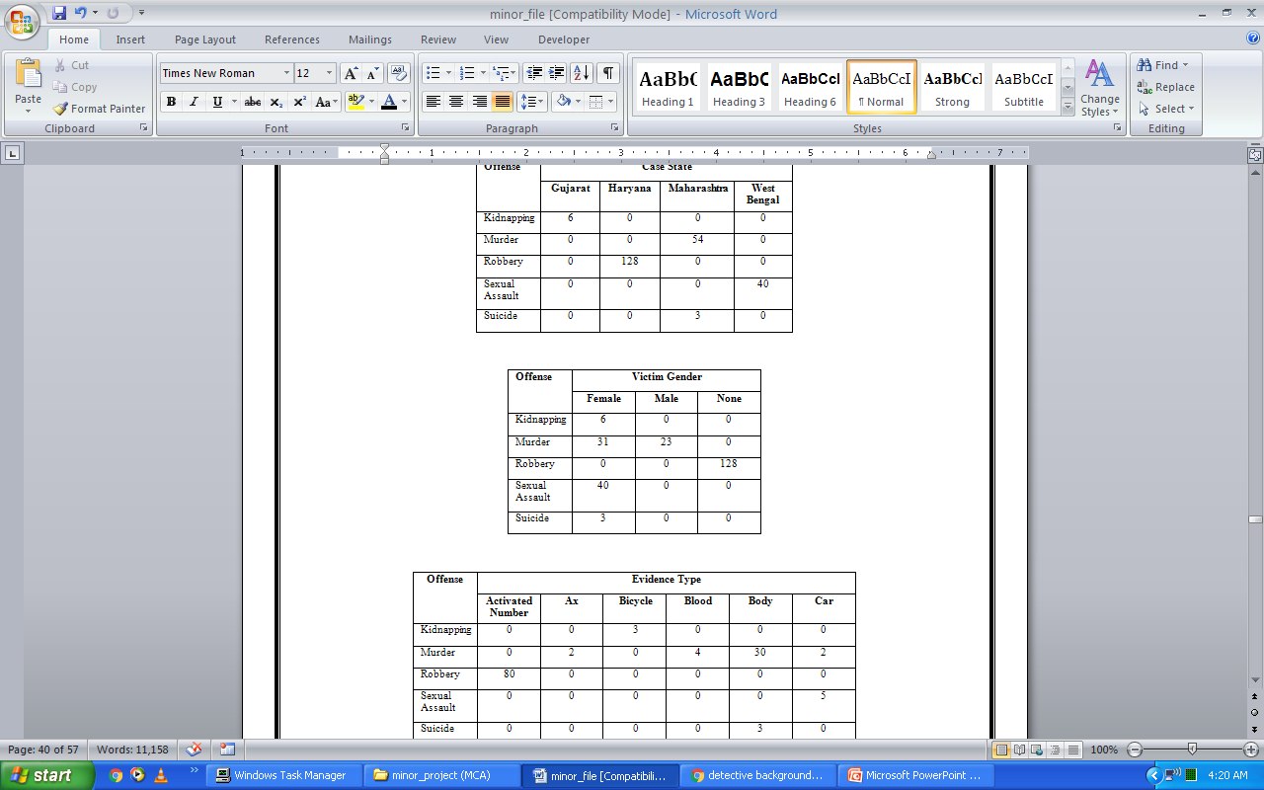

Slide 35
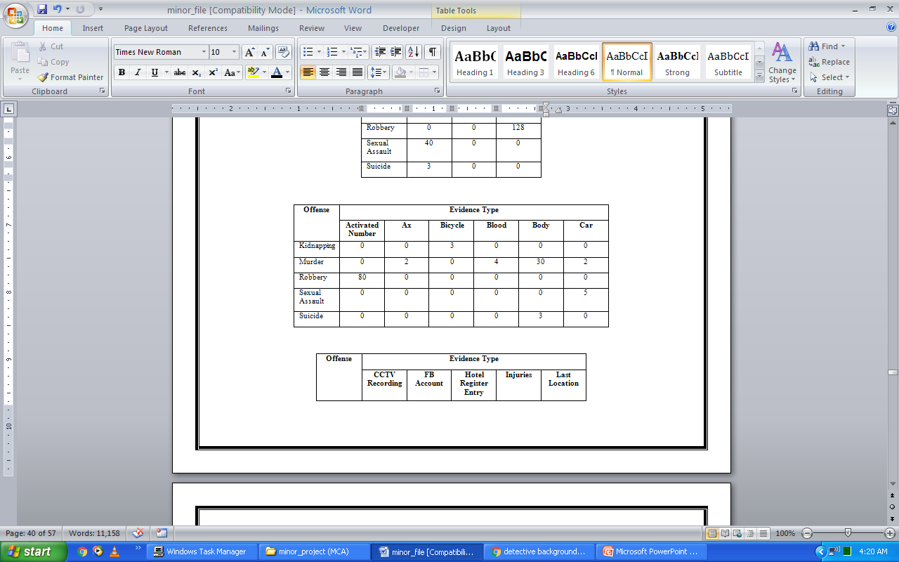
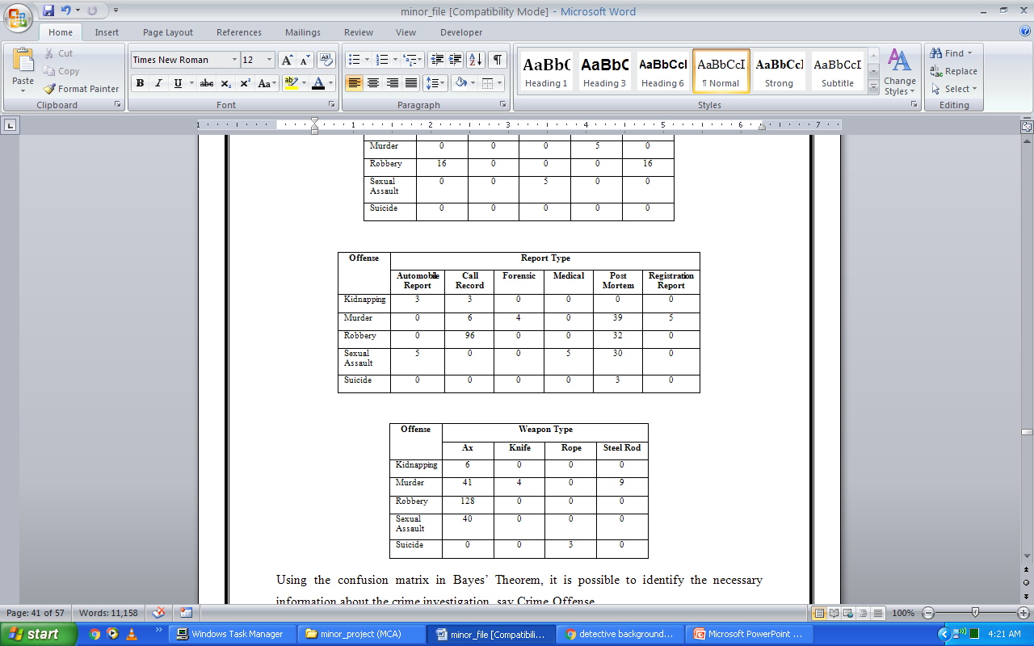

Slide 36
Applying Bayes’ Theorem
Sample Size = 250
Appling Bayes’ Theorem
Predicting the results (Crime Offense)
Sample# | Predicted | Actual
1 | Kidnapping | Murder
2 | Murder | Murder
3 | Murder | Murder
4 | Murder | Murder
5 | Murder | Murder
6 | Murder | Murder
7 | Murder | Murder
8 | Murder | Murder
9 | Murder | Murder
10 | Murder | Kidnapping

Slide 37
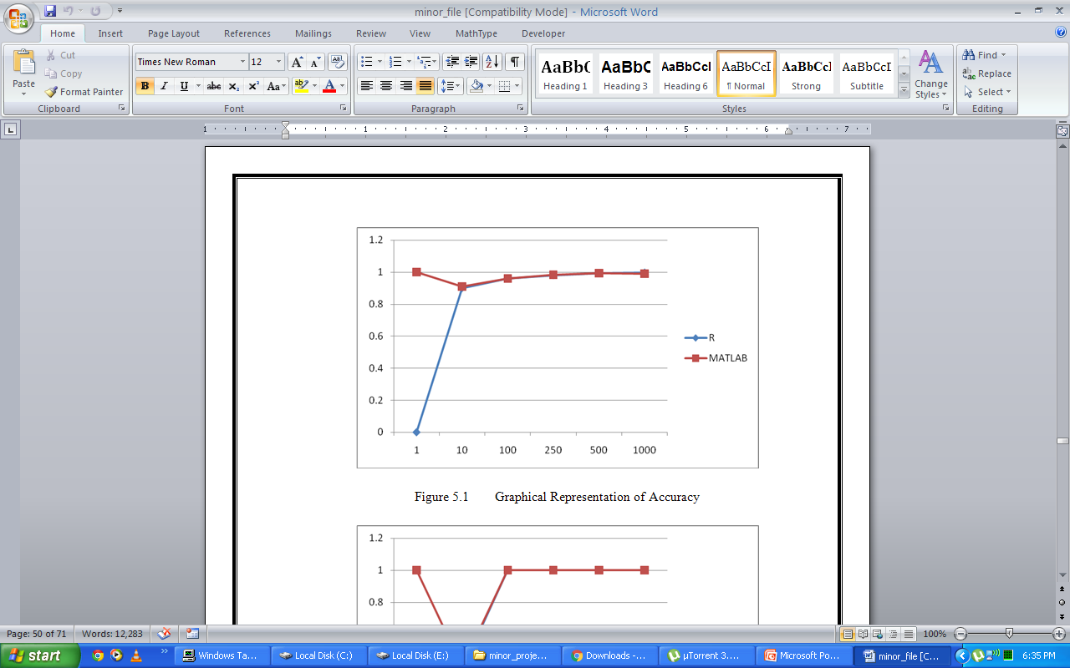
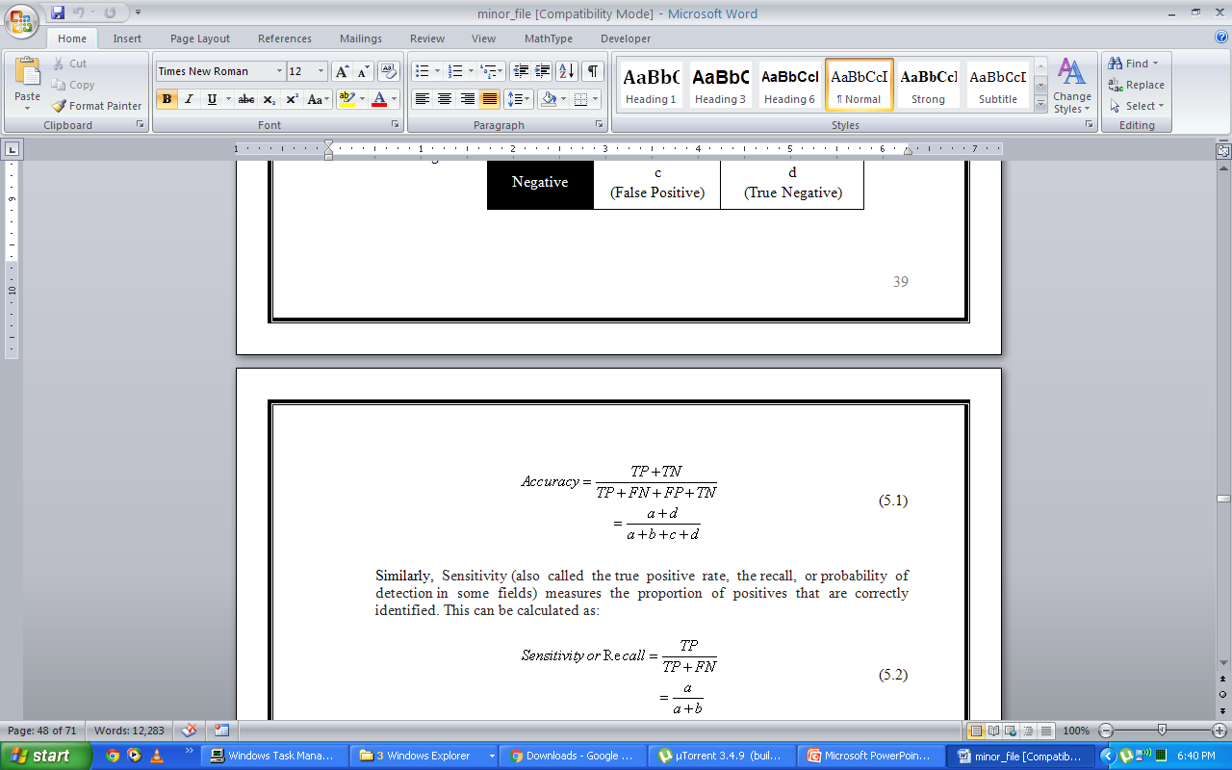
Calculating Accuracy
 |  | Predicted
 |  | Positive | Negative
Target | Positive | a (True Positive) | b (False Negative)
 | Negative | c (False Positive) | d (True Negative)

Slide 38
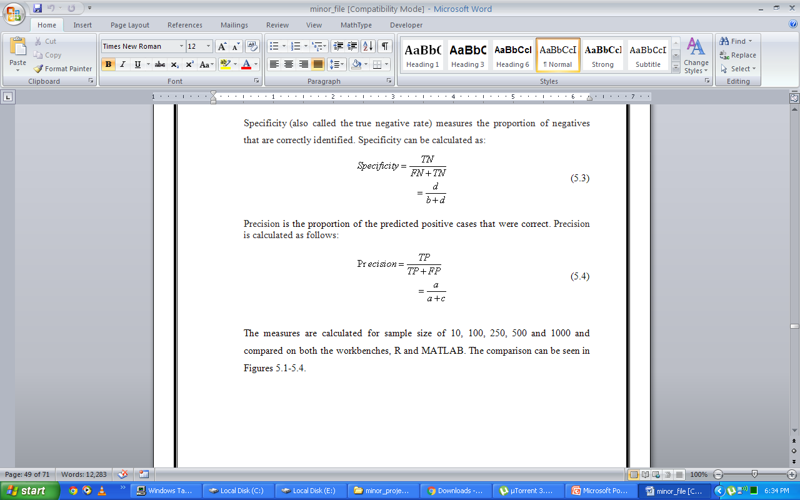
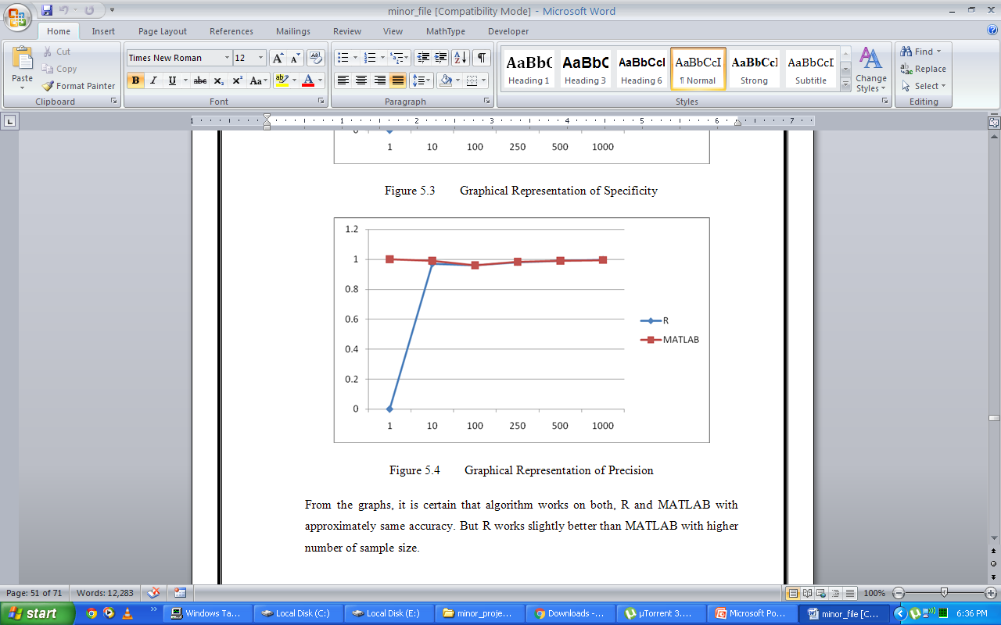
Calculating Precision

Slide 39
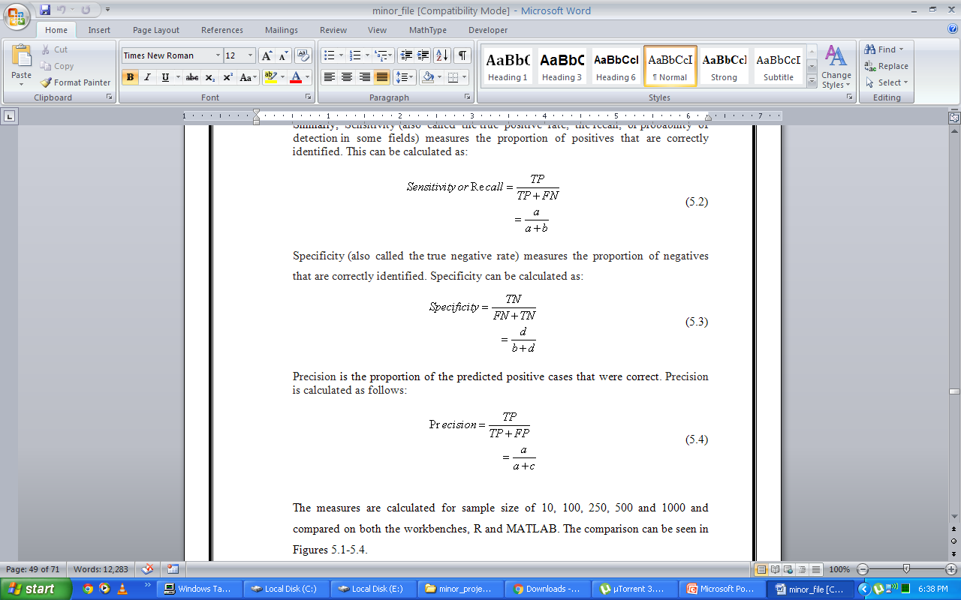
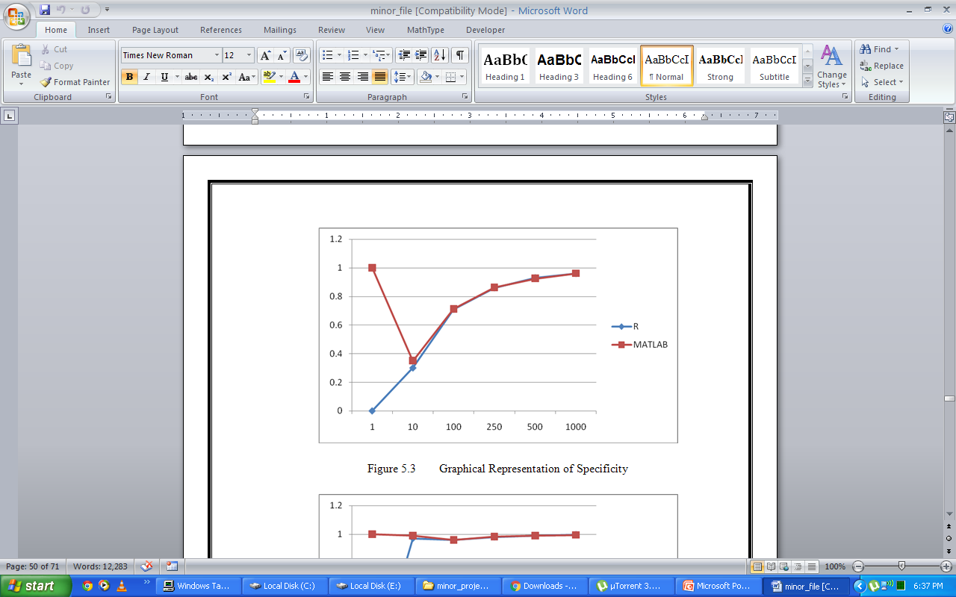
Calculating Specificity

Slide 40
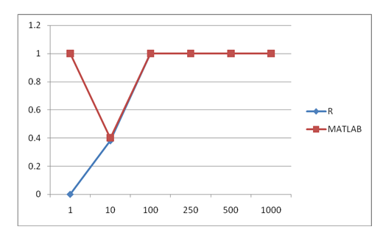
Calculating Sensitivity or Recall

Slide 41
Implementation Code in R
#Changing the columns in required data type
case$District<-as.character(case$District)
complaint$Name<-as.character(complaint$Name)
evidence$Whose<-as.character(evidence$Whose)
#Merging the tables
library(dplyr)
criminals1<-merge(criminals,suspects,by="SuspectId",all=T)
evidence1<-merge(evidence,reports,by="ReportId",all=T)

Slide 42
# Checking the correlation between the variables
table(case1$Offense,case1$RegisteredYear)
table(case1$Offense,case1$CaseState)
# Calculating the Bayesian Probability of offense
library(e1071)
fit<-naiveBayes(Offense~., data=case1)
pred<-predict(fit,newdata[-c(11)],type="class")

Slide 43
# Calculating Measures
library(caret)
confusionMatrix(pred,actual,mode="everything")

Slide 44
Implementation Code in MATLAB
% Adding names to table columns
case1=dataset({case1 'CaseId', 'CaseRegisteredYear', 'CaseRegisteredMonth', 'CaseRegisteredDate', 'CaseActualYear', 'CaseSolvedYear', 'CaseCountry', 'CaseState', 'CaseCity', 'Offense'});
policestation1=dataset({policestation1 'PoliceStationId', 'CaseId', 'PoliceStationCountry', 'PoliceStationState', 'PoliceStationCity'});
%Merging the tables and exclude extra columns
criminal2=join(criminal1,suspect1,'Keys','SuspectId');
criminal2=join(criminal2,victim1,'LeftKeys','victimId','RightKeys','VictimId');
case2(:,[12,17,26])=[];
evidence2(:,[5,6])=[];

Slide 45
% Missing Value Treatment
case2.ComplaintYear(isnan(case2.ComplaintYear))=2013;
case2.ComplaintGender(isnan(case2.ComplaintGender))=2;
case2.ComplaintDominantHand(isnan(case2.ComplaintDominantHand))=2;
% Checking the correlation between the variables
confusionmat(case2.Offense,case2.CaseRegisteredYear);
confusionmat(case2.Offense,case2.CaseState);

Slide 46
% Calculating the Bayesian Probability of offense
fit=NaiveBayes.fit(double(case2(:,[1:9,11:53])), case2.Offense,'Distribution', 'mn');
%Creating new Dataset
newdata1=[2011,11,4,2011,2011,1,1,3,1,1,1,1,1,1,3,1,1,2,1,2,1,0,1,1,3,1,1,3,2,2011,34,1,1,4,2,6,0,2,2012,4,2,1,1,3,2,1,1,2012,2];
newdata1=dataset({newdata1 'CaseRegisteredYear','CaseRegisteredMonth','CaseRegisteredDate','CaseActualYear','CaseSolvedYear','CaseCountry','CaseState','CaseCity','CriminalStatus','SuspectGender','SuspectDominantHand','SuspectRationshipWithVictim','SuspectCountry','SuspectState','SuspectCity','SuspectOccupation','SuspectArrestedFrom','VictimGender','VictimDominantHand','VictimChildren','VictimMaritialStatus','VictimSiblings','VictimRankInSibling','VictimMotherStatus','VictimFatherStatus','VictimCountry','VictimState','VictimCity','VictimOccupation','ComplaintYear','ComplaintAge','ComplaintGender','ComplaintDominantHand','ComplaintRelationWithVictim','ComplaintOccupation','EvidenceType','ReportDate','ReportMonth','ReportYear','ReportType','ReportResults','PoliceStationCountry','PoliceStationState','PoliceStationCity','WeaponType','MainWeapon','WitnessGender','WitnessYear','EyeWitness'});
actual1=(1);
prediction=predict(fit,double(newdata));

Slide 47
% Calculating Measures
cm=confusionmat(prediction,double(case2(1:10,10)));
n=sum(sum(cm)); diag=diag(cm); accuracy=sum(diag)/n;
precision=diag/rowSums(cm);
precision(isnan(precision))=0;
recall=diag/colSums(cm);
recall(isnan(recall))=0;
specificity=(sum(diag)-diag)/((sum(diag)-diag)+(rowSums(cm)-diag));

Slide 48
Conclusion
All the perspective of current system using in investigating the crime are studied
A plot is thought for a new system depending upon the latest technology.
The proposed system can be used in replacement of current system giving better results. It also lessens the investigator’s burden and helps him to identify the actual offense and even the actual culprit of the criminal activity.
For this purpose, the new approach of machine learning and conditional probability is used which can be done using Bayes’ Theorem.
For making statistical work easy and effective, R and MATLAB are chosen as workbenches.
After plotting everything, feasibility study has been done.
Data is collected, imported in R and MATLAB, preprocessing is done and then chosen algorithm is applied.
For judging the performance, accuracy, precision, specificity and sensitivity are calculated and plotted.

Slide 49
Suggestions For Further Study Or Further Improvement
The algorithm can further be test on other statistical platform such as Julia.
The data is collected manually in proposed system. Image processing can be introduced in the system as to collect data by system itself.
The collected data can be stored in any form whether structured or unstructured using the Big Data technology such as Hadoop ecosystem.
The system can be further made as an expert system which can also give reply against the random questions asked by the user about the crime investigations.

Slide 50
Thank You
Sonali Chawla
AU124060202002P

